Slide 1

Capstone Project Report On
“TRAVEL APPROVAL APP”
BY:
Name: Akshay Pusuluri
Batch WIP-SF-13
LMS Id: MGSA_510

Slide 2

CONTENTS
INTRODUCTION TO SALESFORCE
INTRODUCTION OF TRAVEL APPROVAL APP
MODULE 1
MODULE 2
MODULE 3
CONCLUSION

Slide 3

INTRODUCTION TO SALESFORCE
What is salesforce?
Why do we use salesforce?
What does Salesforce do?
What are the benefits of Salesforce ?
What is CRM
What is Cloud Computing

Slide 4
INTRODUCTION OF TRAVEL APPROVAL APP
The travel approval project in Salesforce is a system designed to automate and streamline the process of requesting and approving travel expenses for employees. The project involves several components, including a custom object to track travel requests, a custom approval process, and various integrations with external systems.
Overall, the travel approval project in Salesforce provides a streamlined and efficient way for employees to request and manage travel expenses, while also providing managers with the tools they need to ensure that all expenses are approved and accounted for.

Slide 5
MODULE 1
This project module focuses on the non-coding approach to modifying the user interface, as you customize an app that tracks company travel.
Create Custom App, Objects, Fields & Relationships, and how you customize the App using declarative tools.
Module Take Away

Slide 6
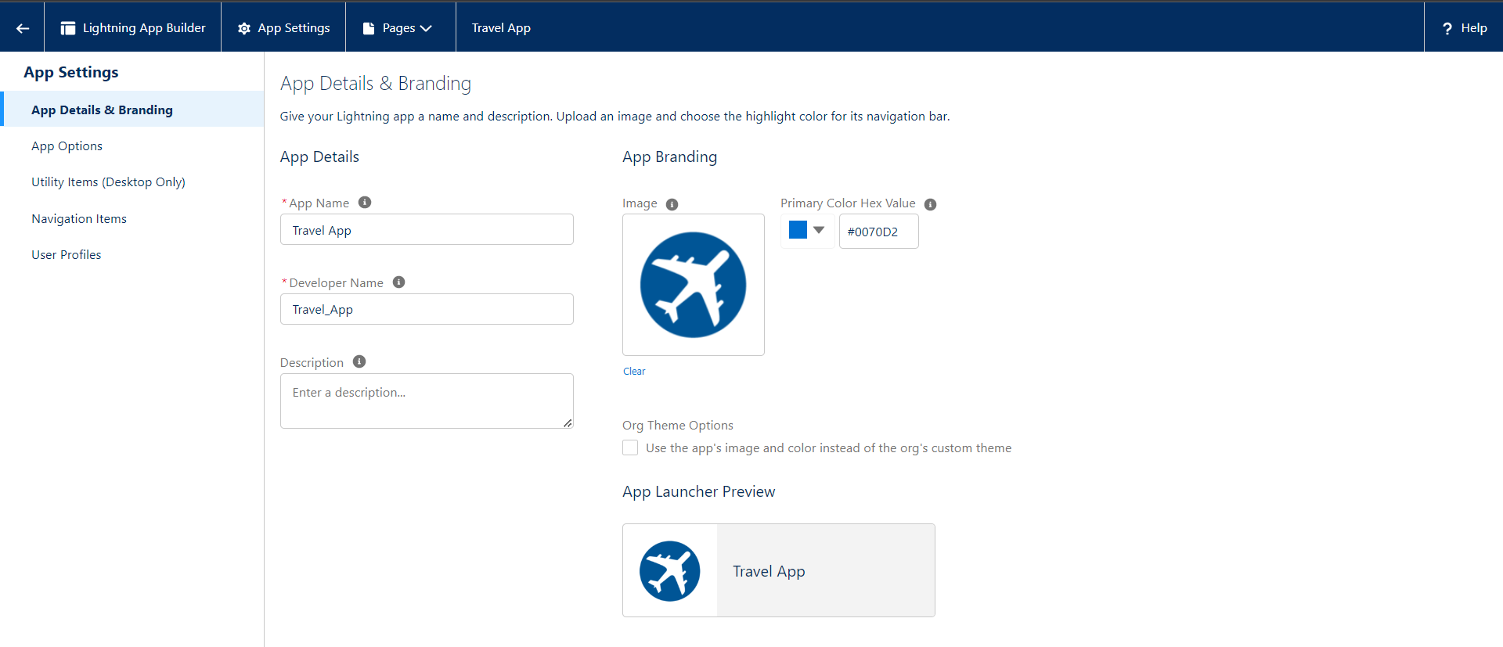
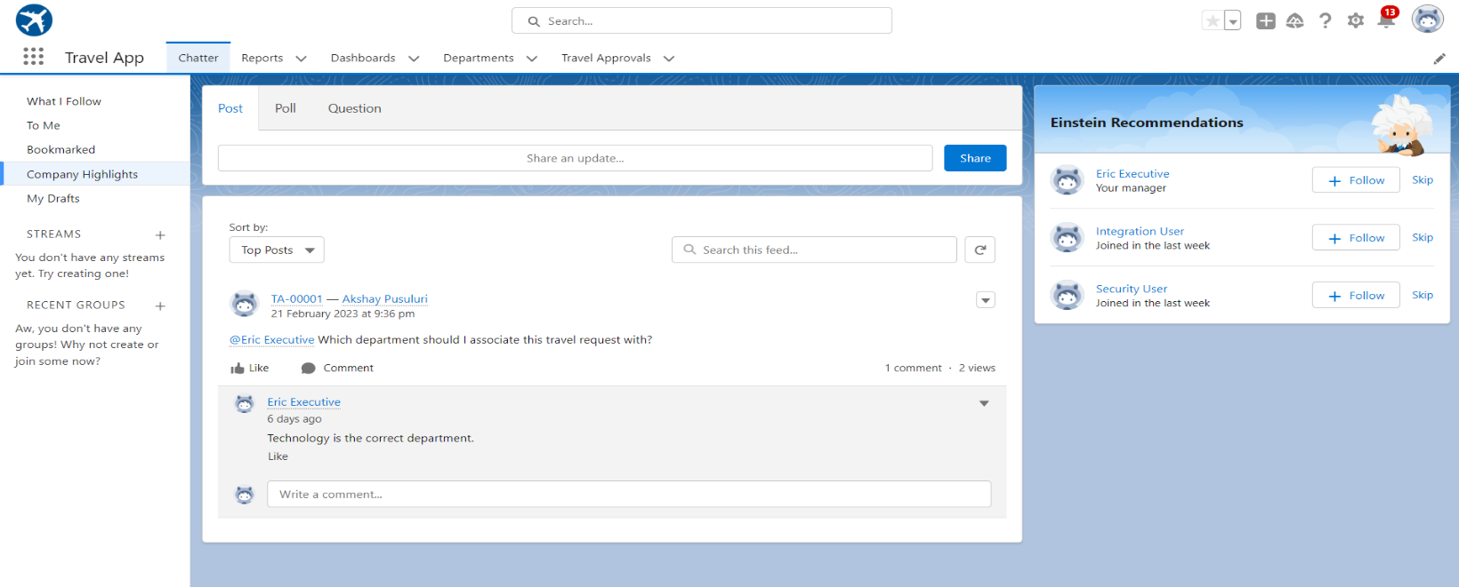
Creating Lightning App: TRAVEL APP

Slide 7
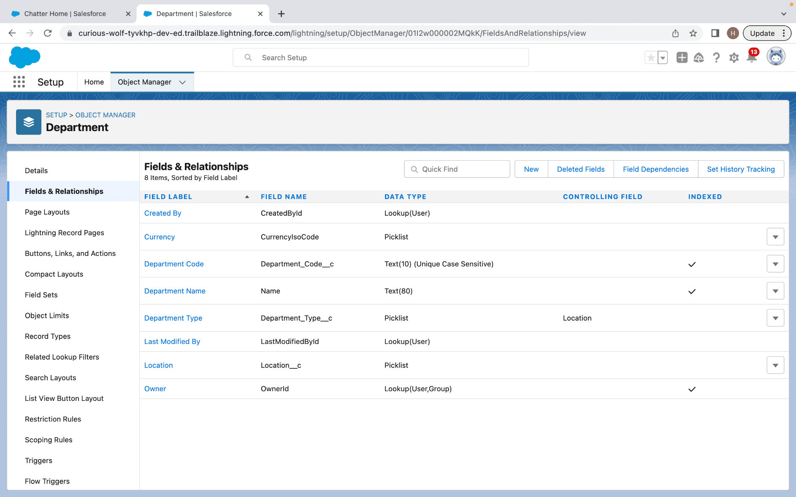
Custom object Department and Creating custom fields in Department Object

Slide 8
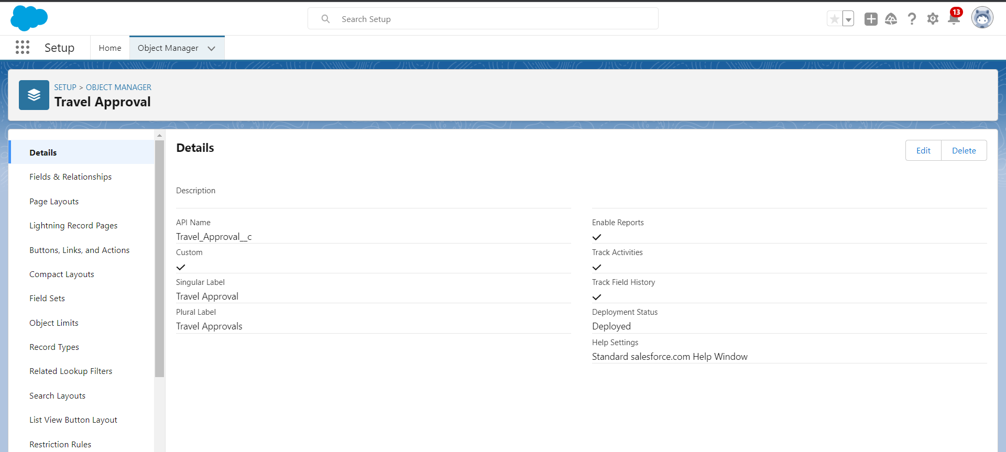
Creating Custom Object Travel Approval and Custom Fields in that Object

Slide 9
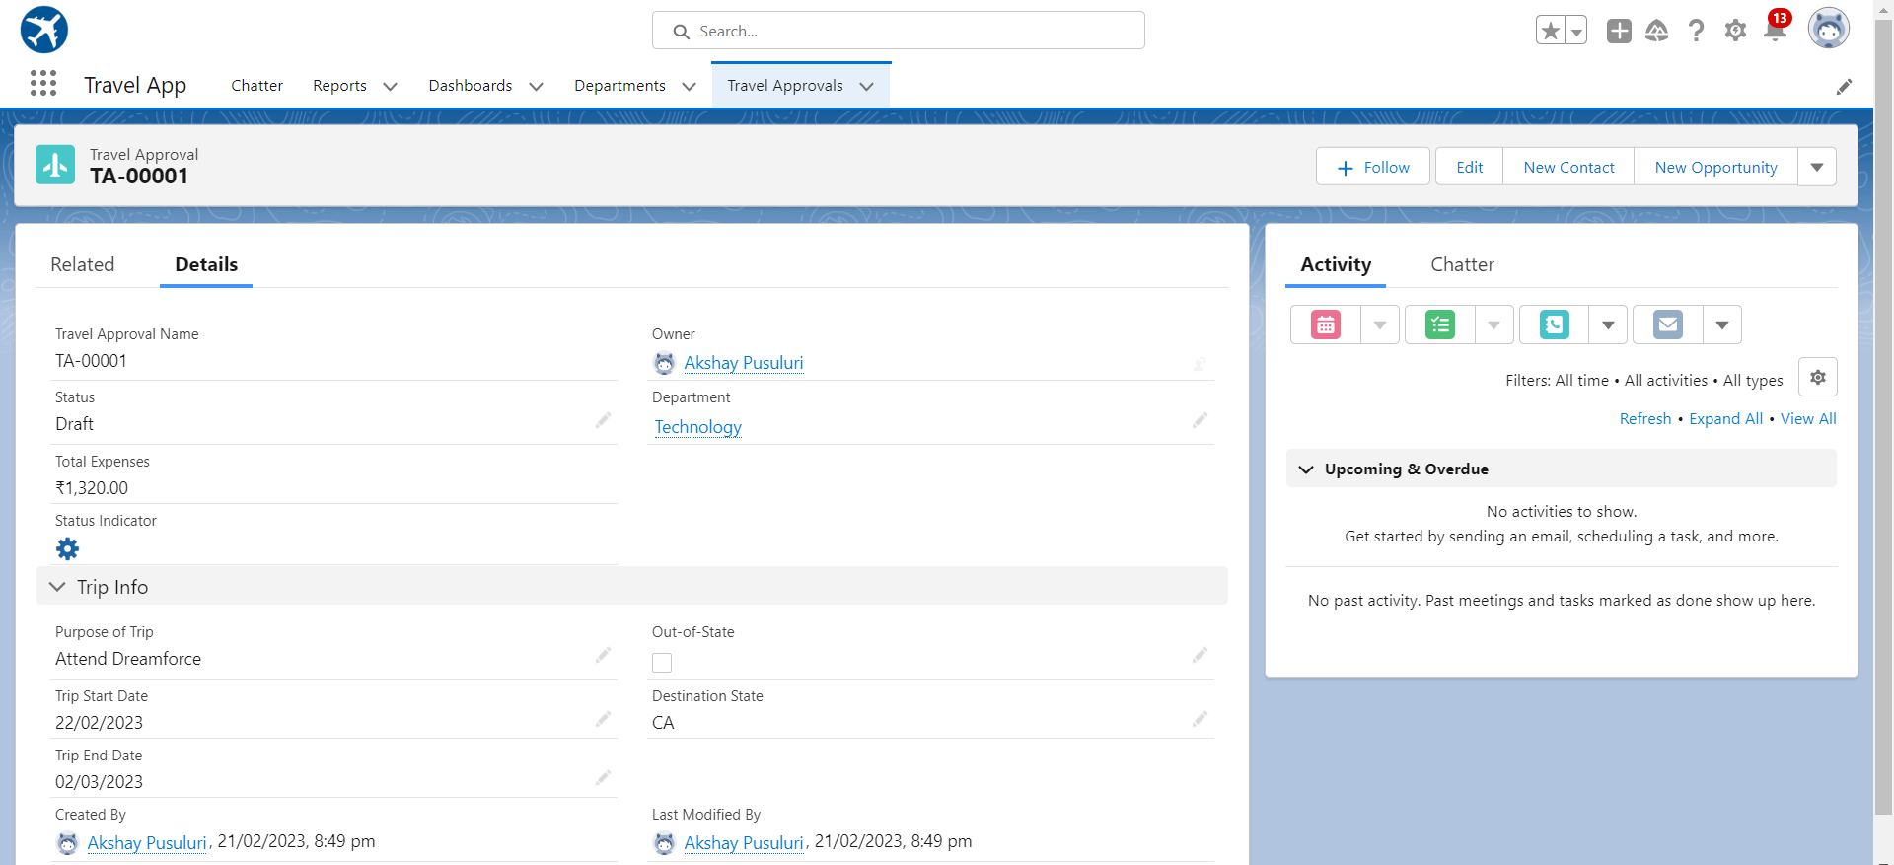
After creating Travel Approval object with fields, it looks as shown below

Slide 10
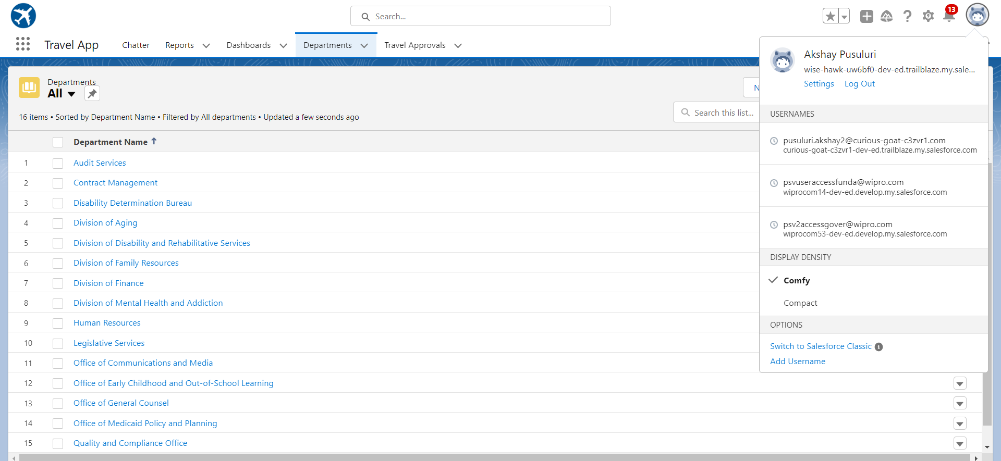
Importing Department records using data import wizard and imported record data status can viewed below

Slide 11
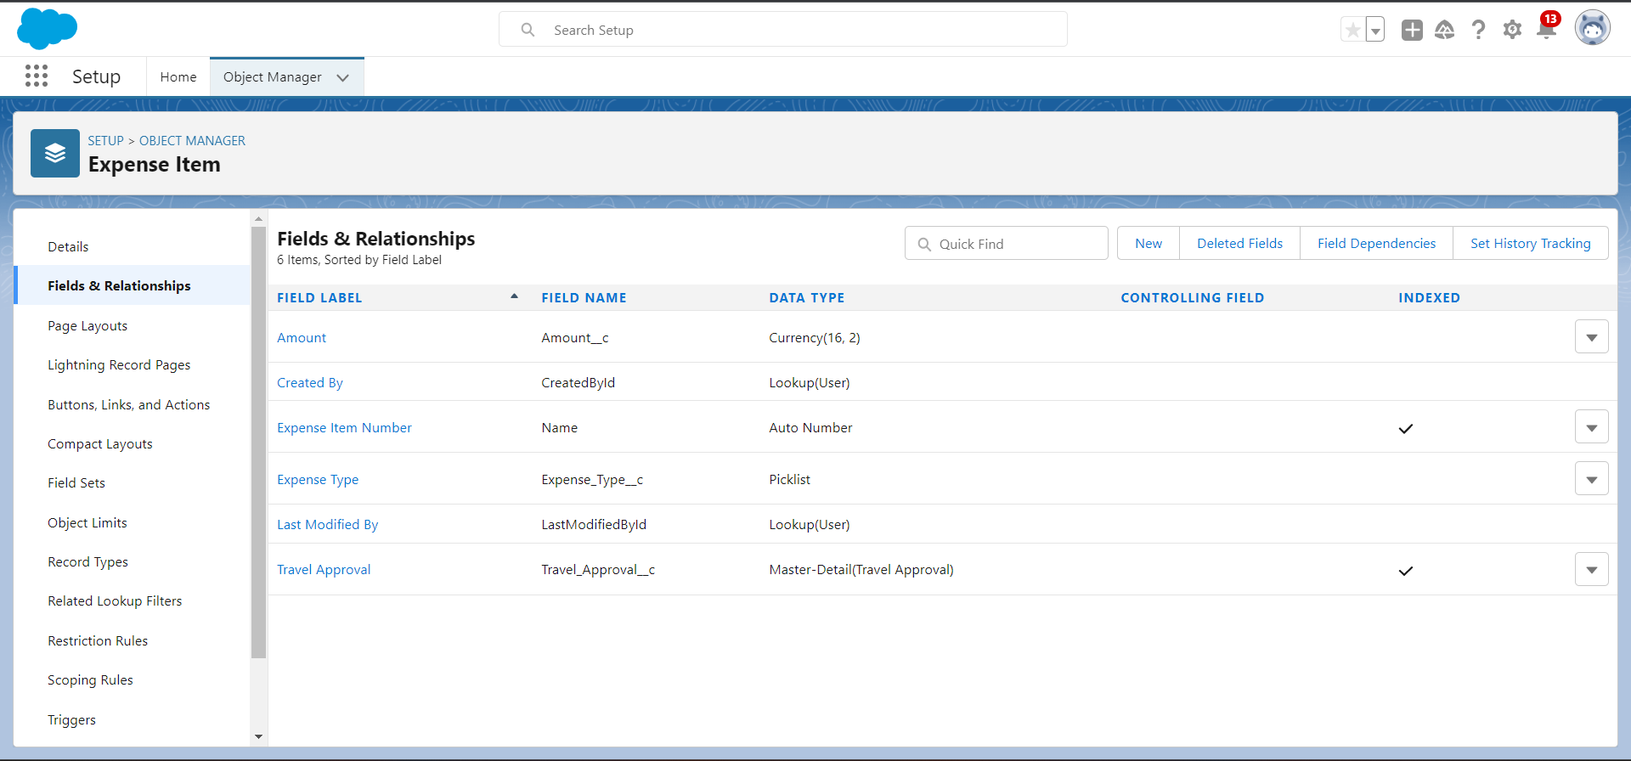
Creating Expense Item custom object and Custom fields in Expense Item object

Slide 12
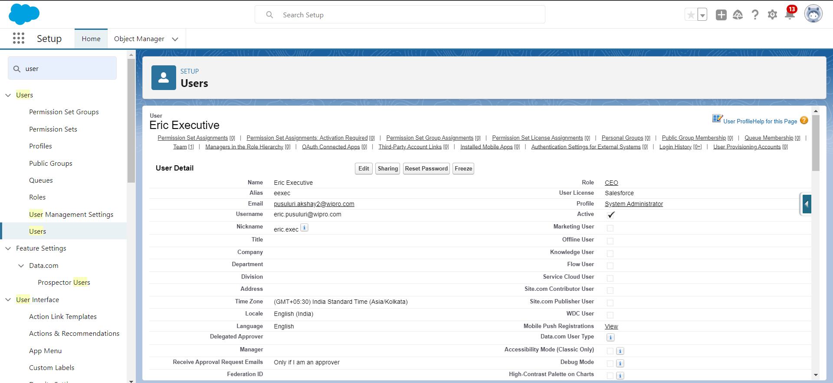
Creating User with
system admin license

Slide 13
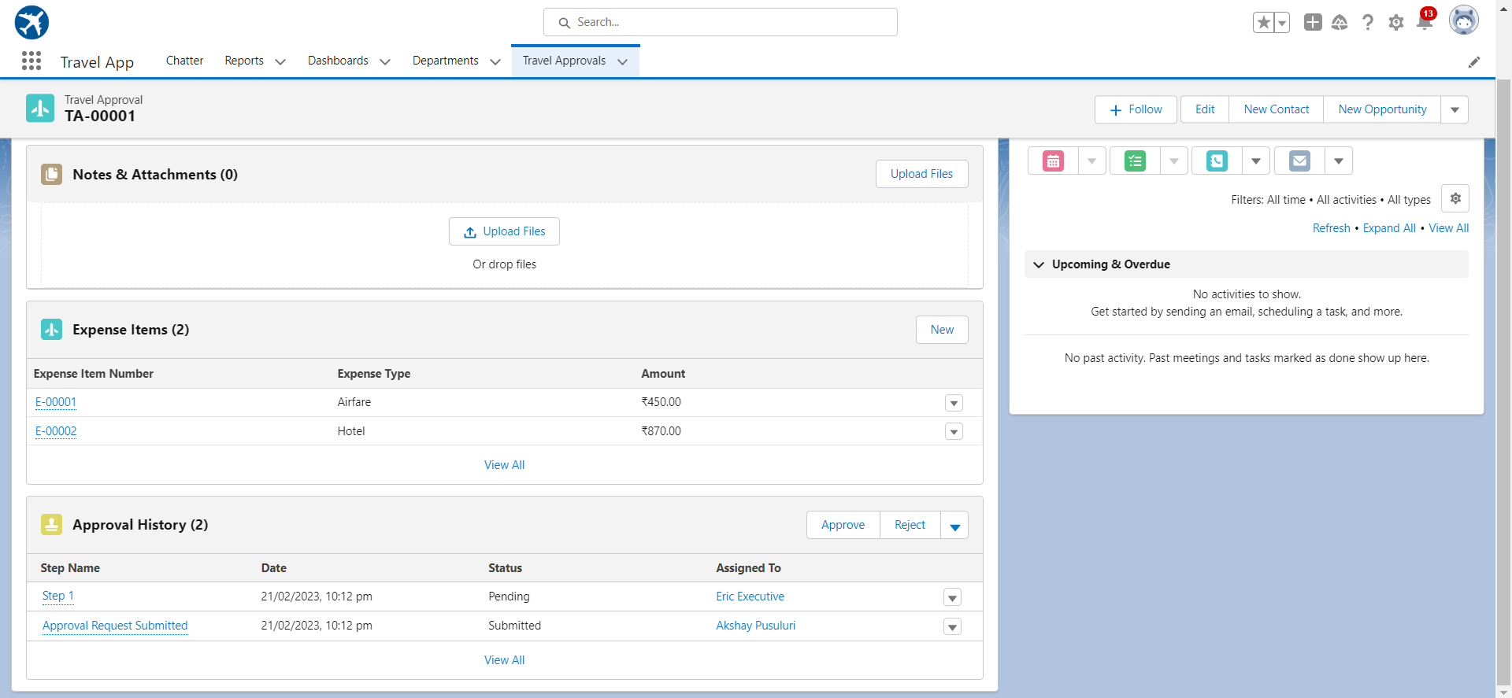
Test the app:

Slide 14
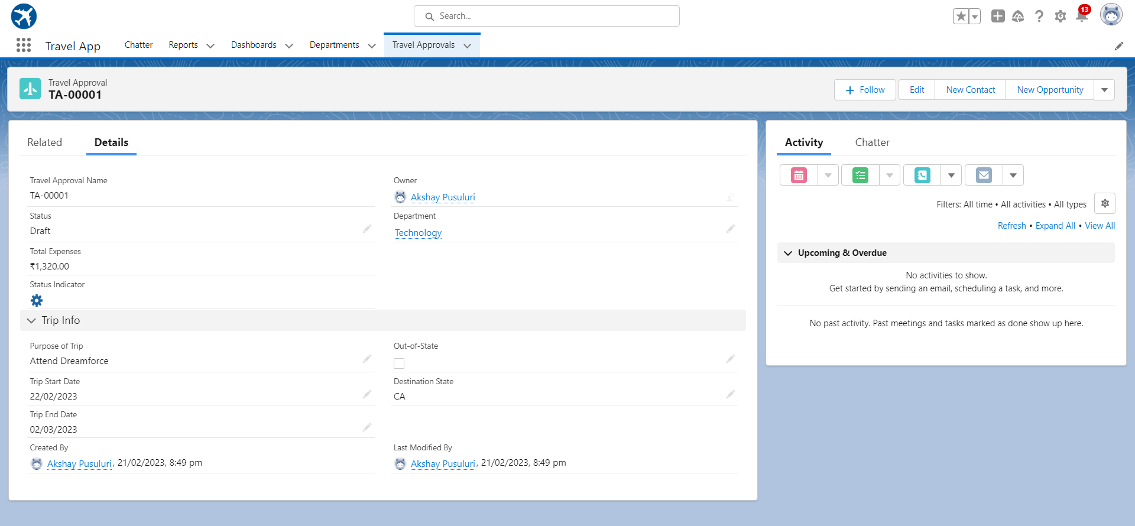

Slide 15

MODULE 2
This project module focuses on the Automation and Analytics Tools to enhance your custom App development.
Define Business logic using Validation rules, Roll-up summary fields, Formulas, Flows & how you track Travel Approvals using Reports and Dashboards

Slide 16
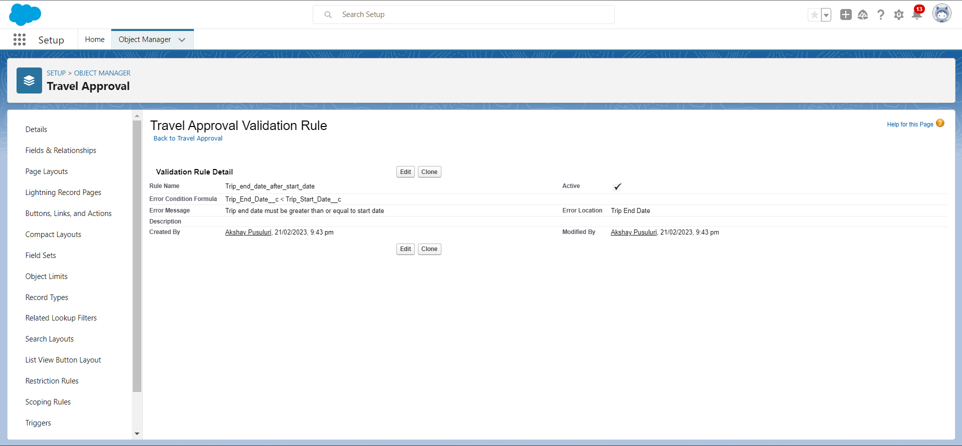
Validation Rule that trip end date always >= start date

Slide 17
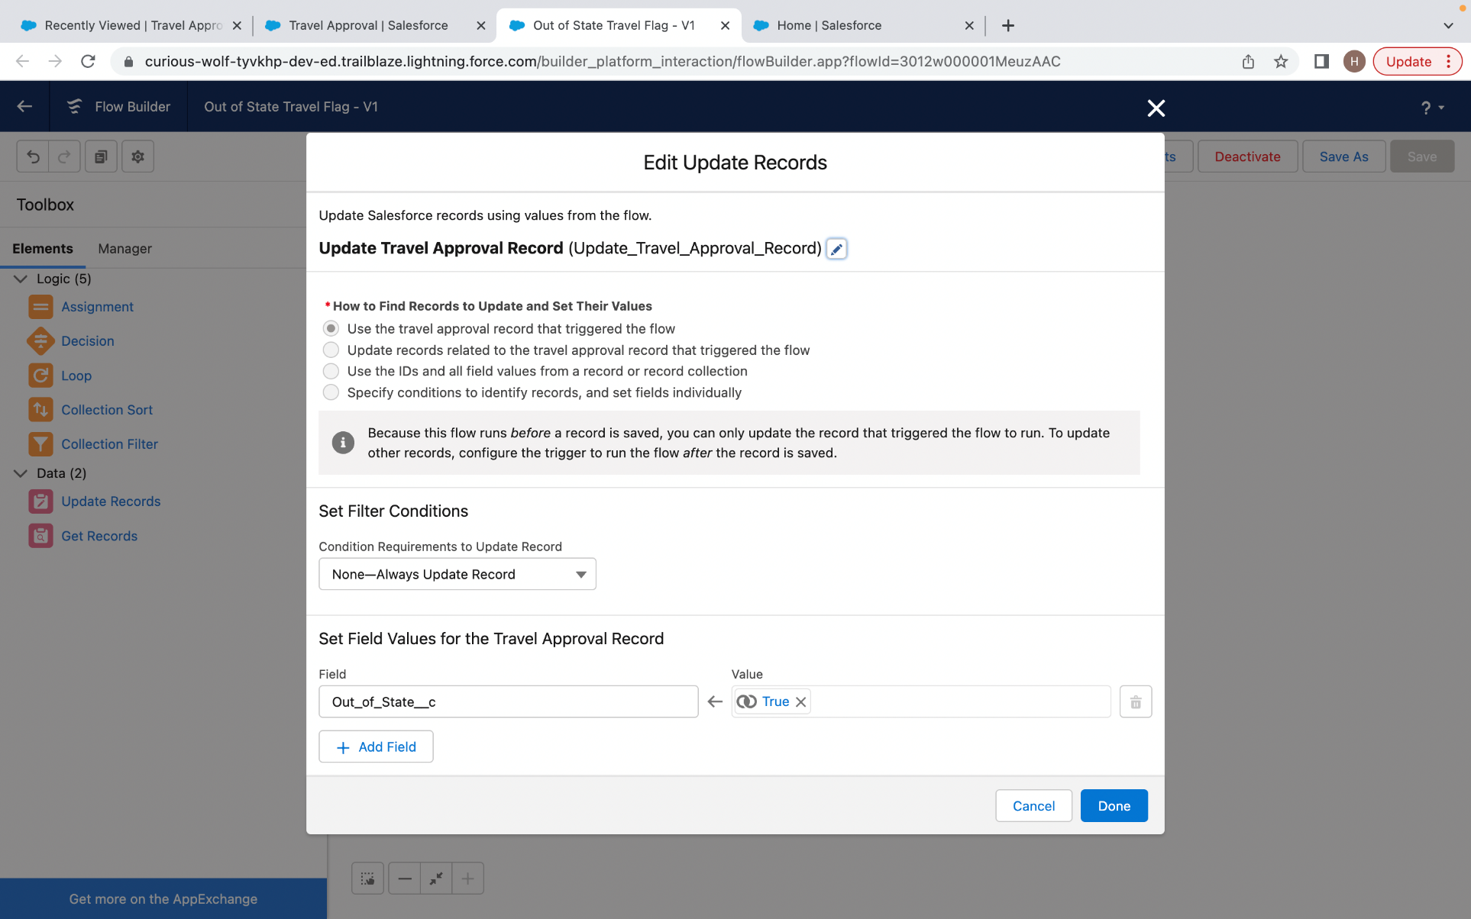
Create a Record – Triggered Flow

Slide 18
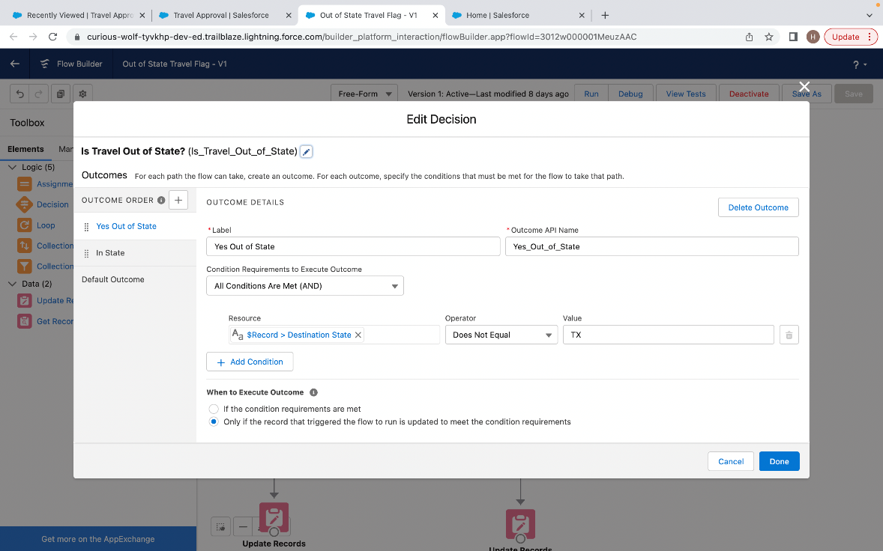
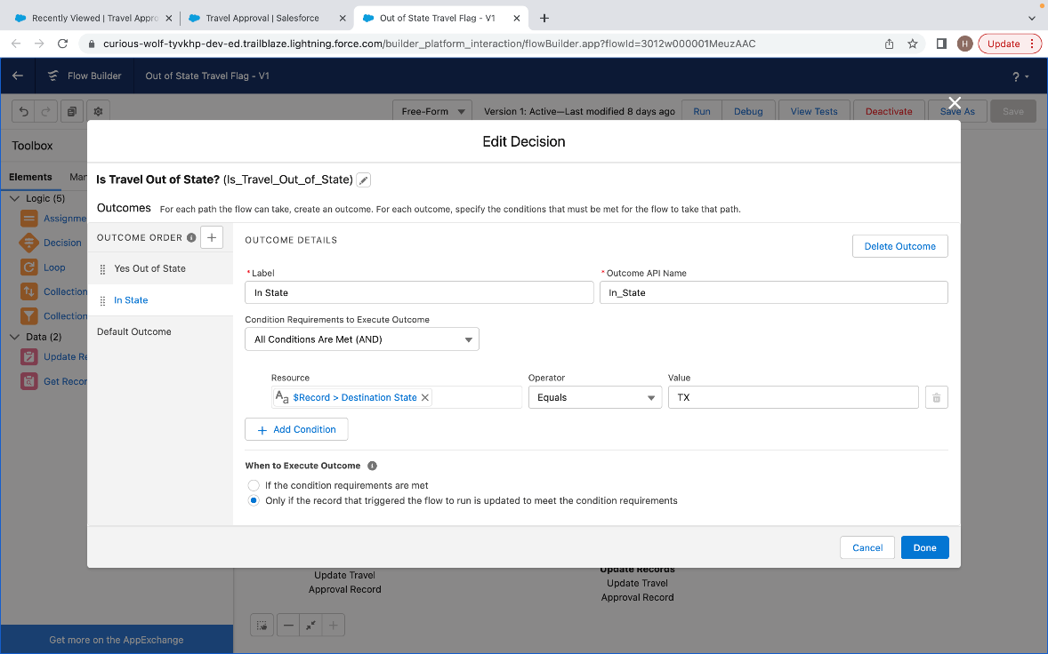
And add Decision element to flow

Slide 19
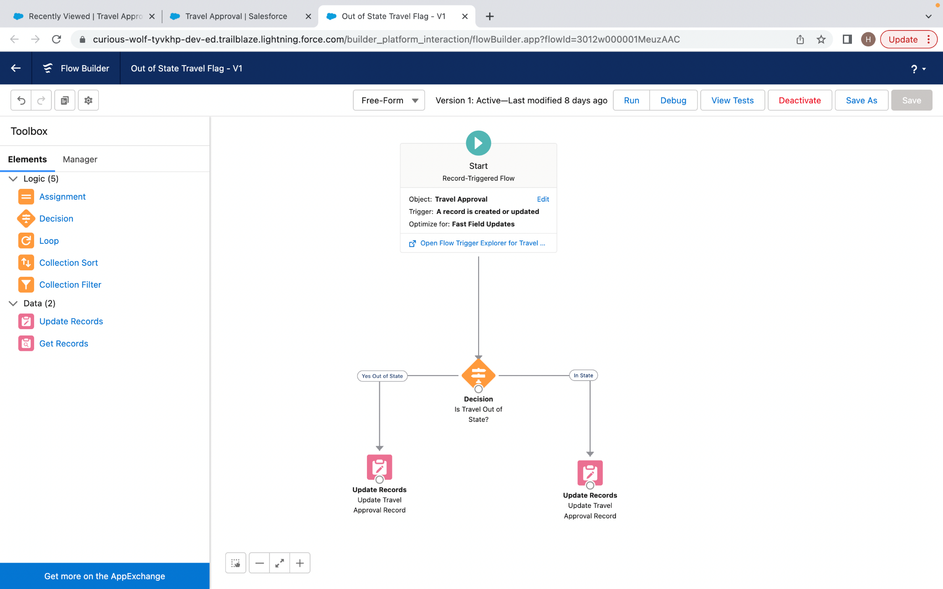
Finally, the flow looks as shown, save and activate

Slide 20
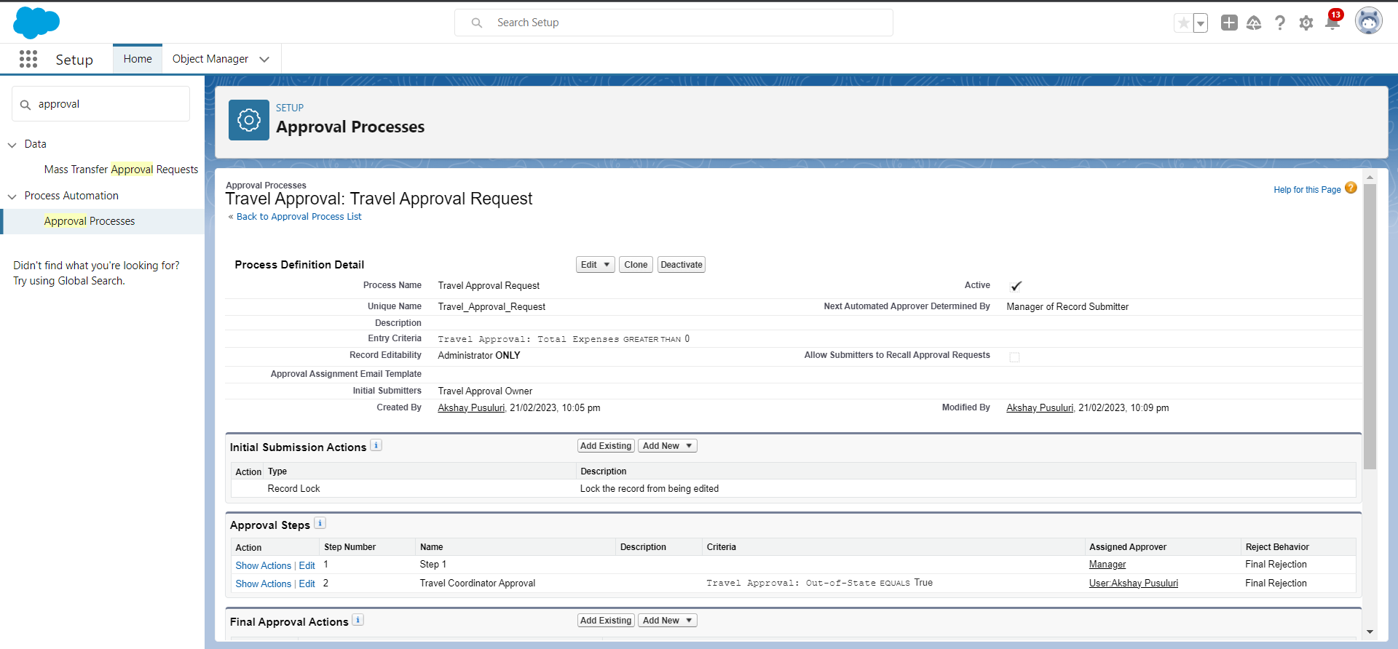
Creating an Approval Process to send travel approvals to manager or travel coordinator

Slide 21
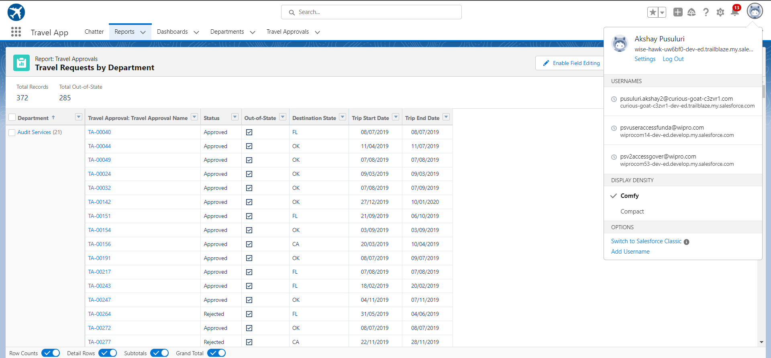
Using Data import wizard to import travel approval records , later the Records imported successfully

Slide 22
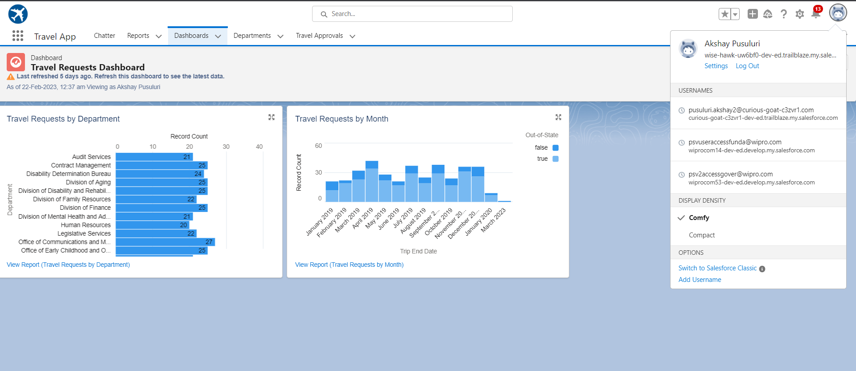
Final Dashboard

Slide 23
MODULE 3
This project module focuses on the coding approach to extend the functional capabilities of your custom App.

Slide 24
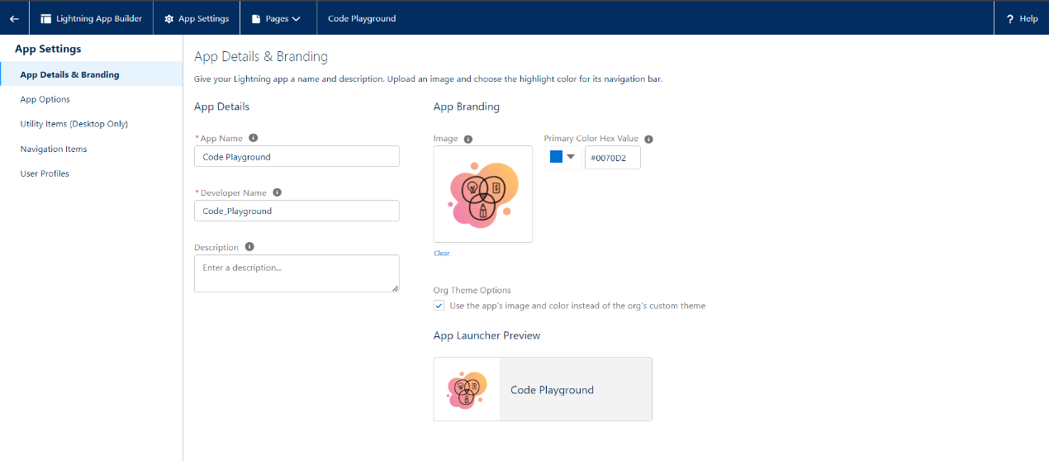
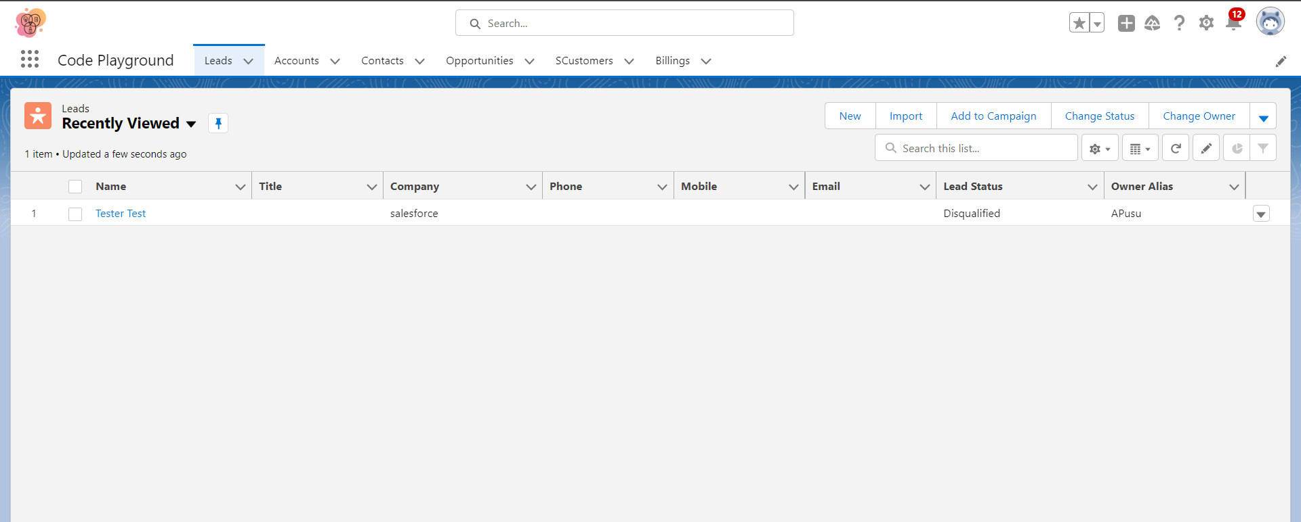
Exercise - 01 Creating Code Playground Lightning App with Lead, Account, Contact, Opportunity, Case to navigation profile as system admin.

Slide 25
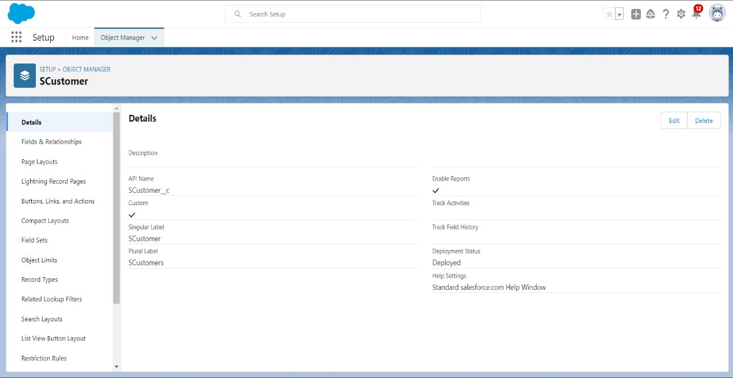
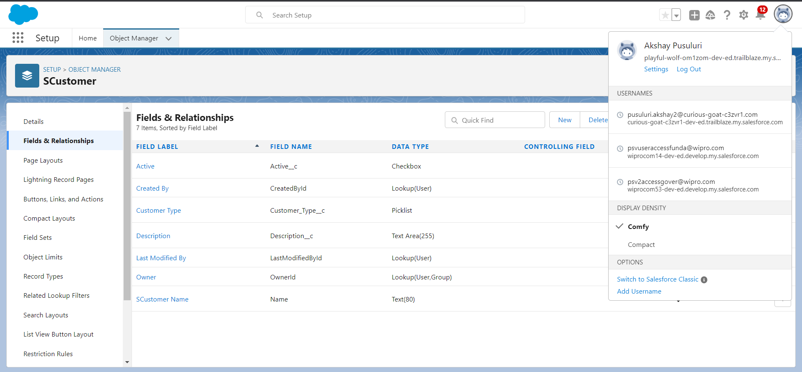
Creating custom object Customer and add related fields

Slide 26
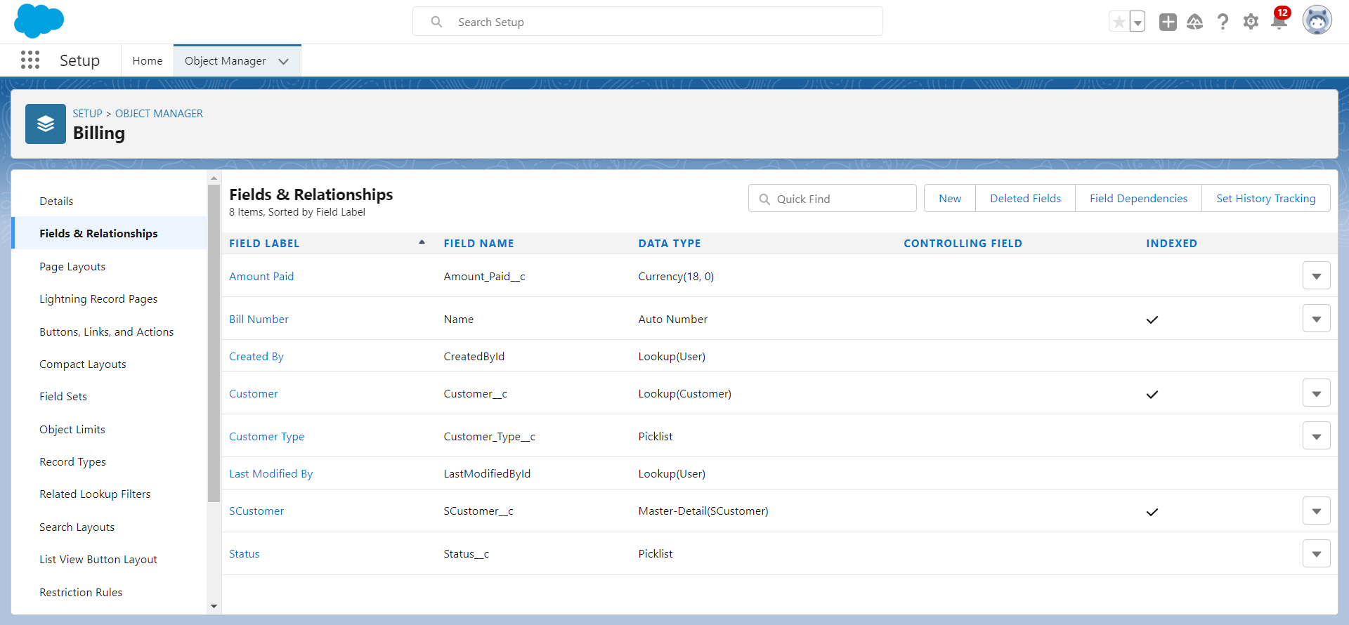
Creating custom object Billing and add related fields

Slide 27
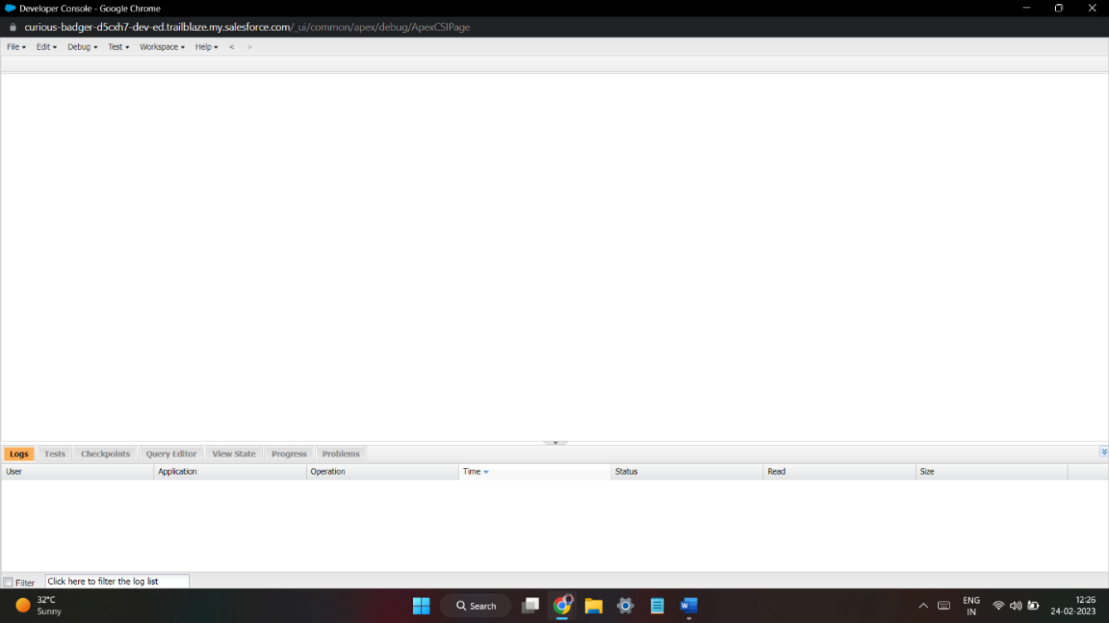
Exercise - 02 Use Execute Anonymous to define and execute the following code: Developer Console

Slide 28
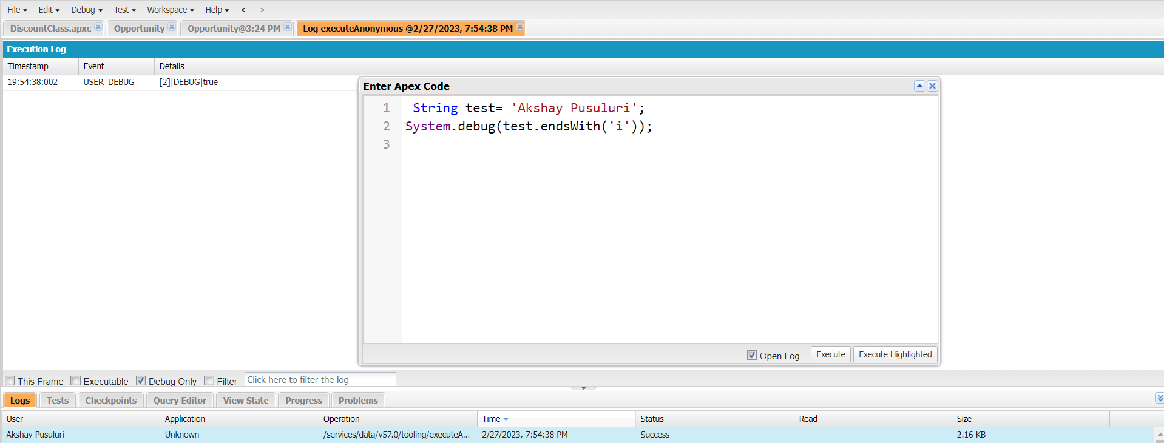
1.Define a String Variable & use string method ‘endsWith’ to display the output. By clicking oh Debug and select open Anonymous window

Slide 29
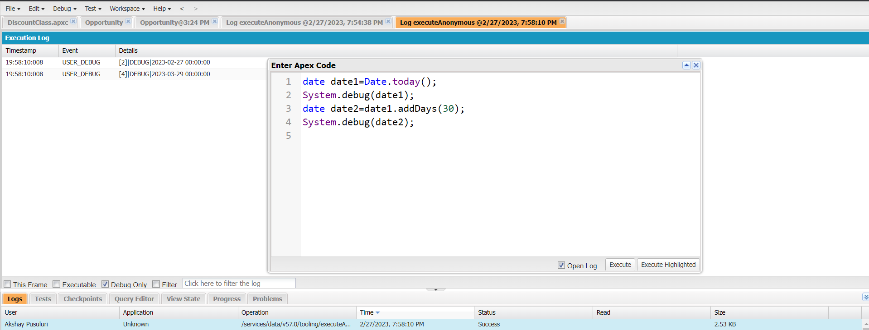
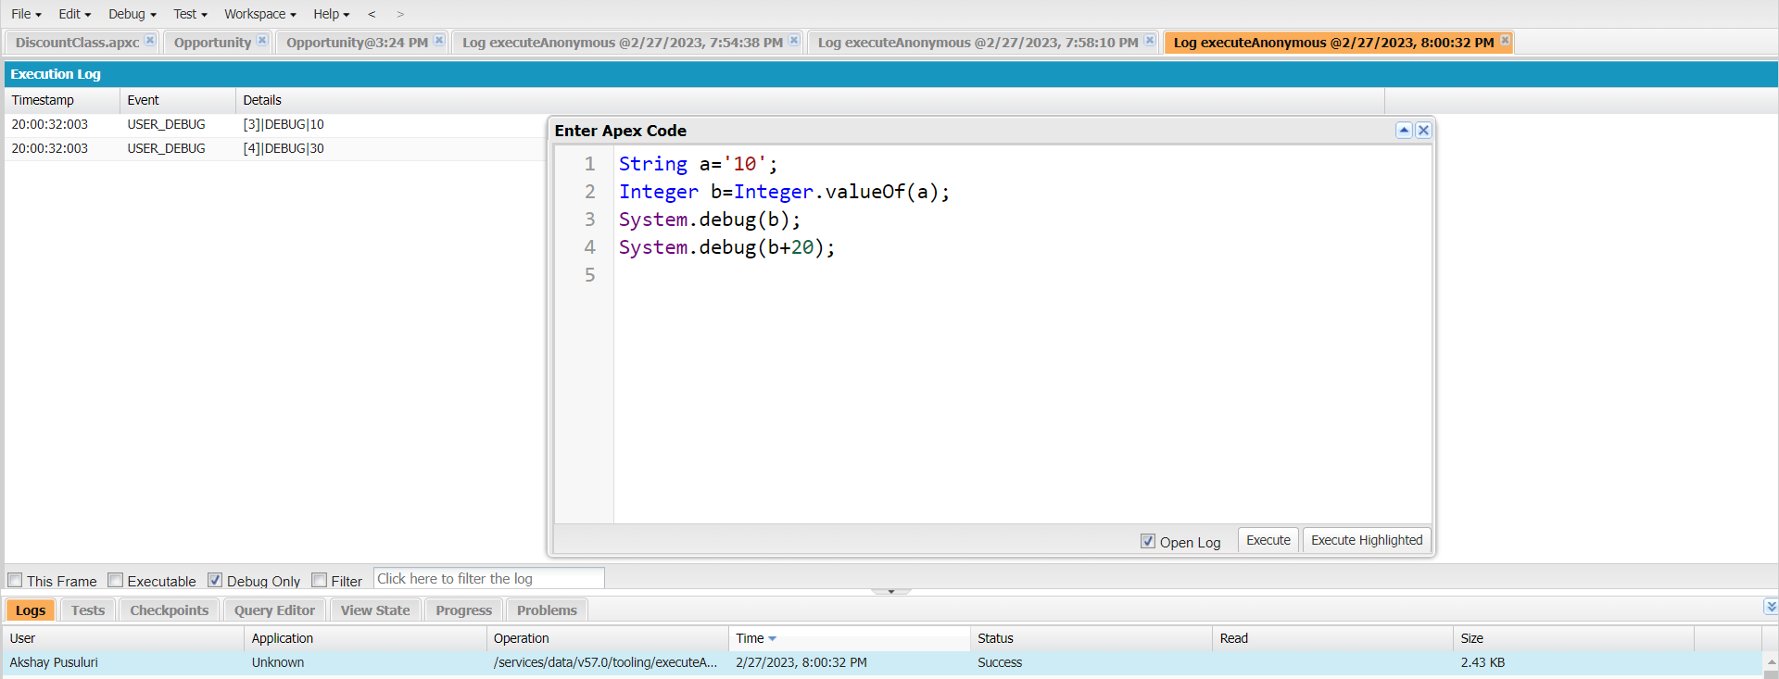
2. Define 2 Date type variables, use Date method today() & addDays(30) to display the output
3. Display the output of an Integer variable from string ‘10’ and then add 20 to it.

Slide 30
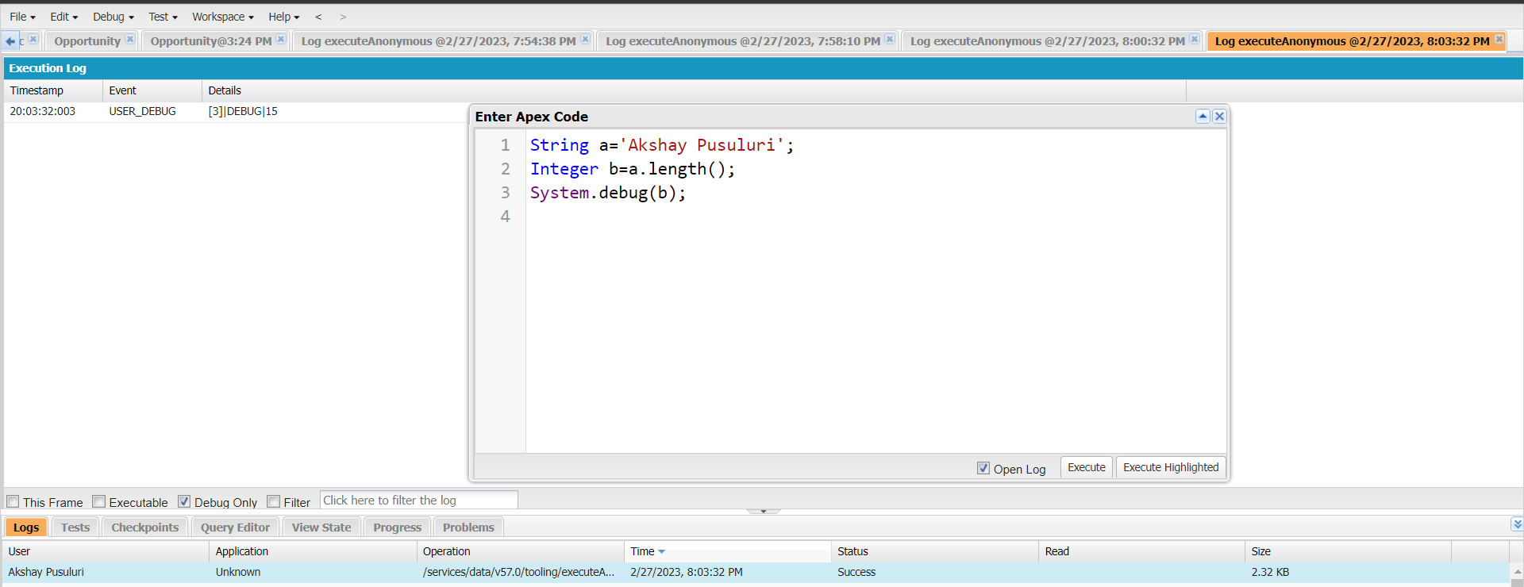
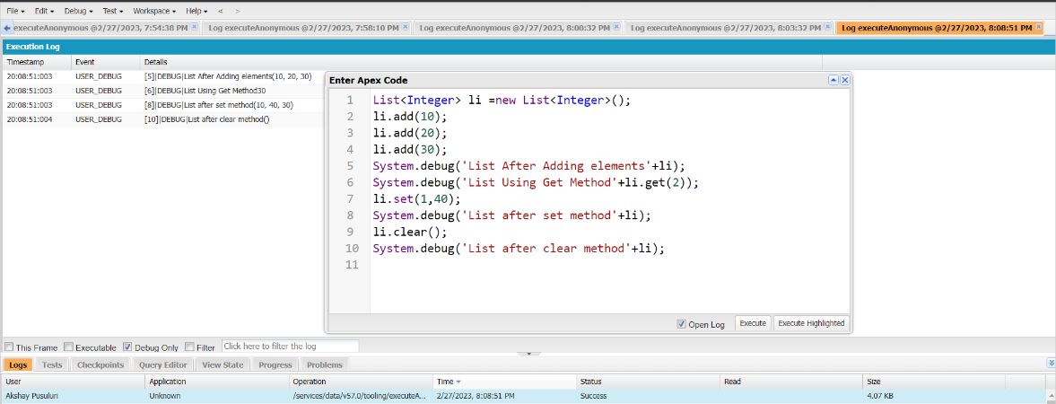
4. Define a String Variable & use string method length() to display the output
5. Define a List of integer and display the output using add(), get(), set(), clear(), methods.

Slide 31
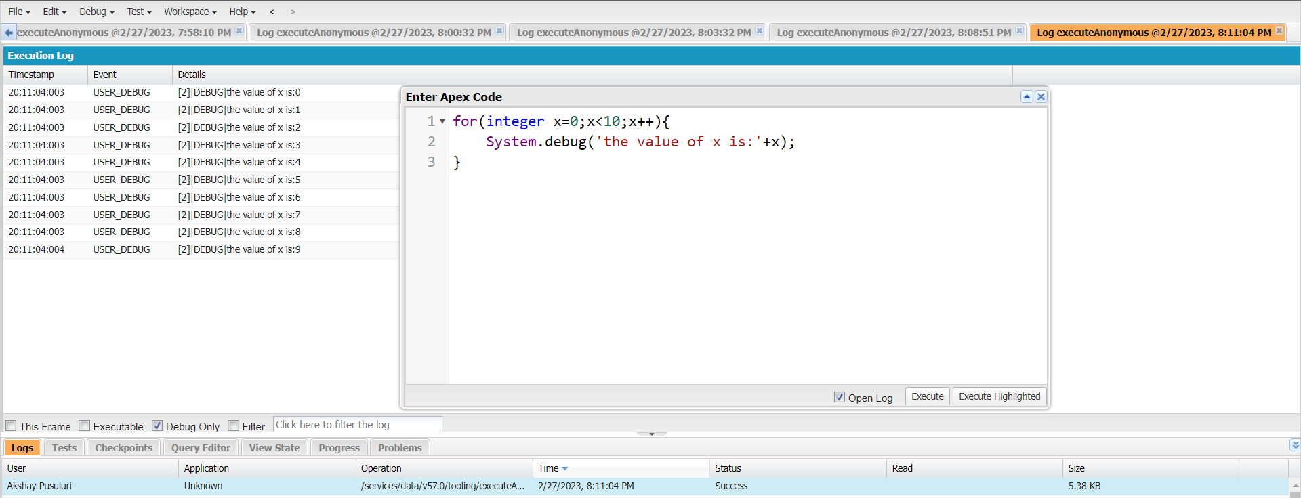
Use Execute Anonymous to define and execute the following code to display the value of x = 0 to 9.

Slide 32
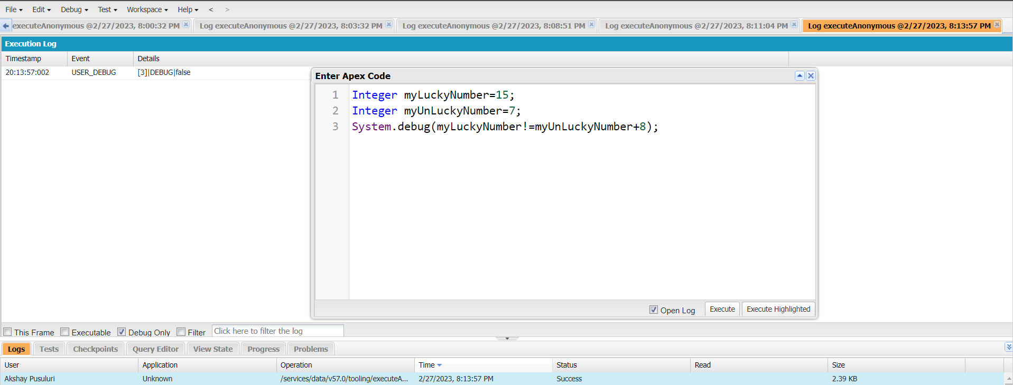
Exercise 3 Answer the following in True or False: Integer myunlucklyNumber = 7; Integer myluckyNumber = 15; myluckyNumber != myunlucklyNumber + 8.

Slide 33
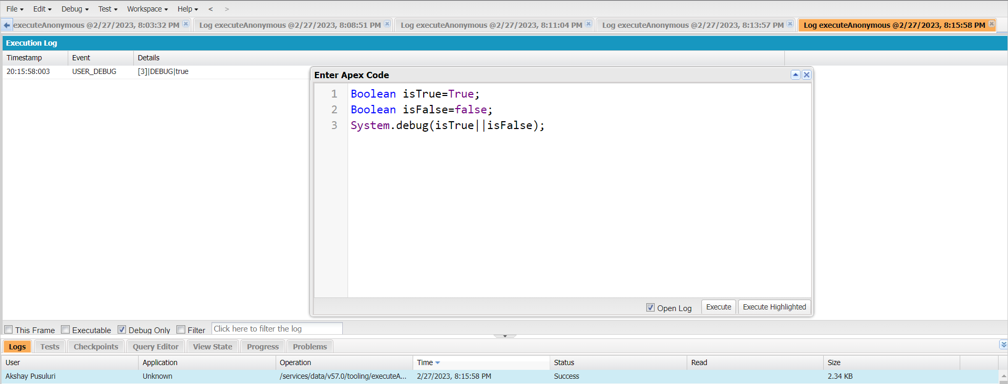
Exercise 4 Answer the following in True Or False: Boolean isFalse = false; Boolean isTrue = true;

Slide 34
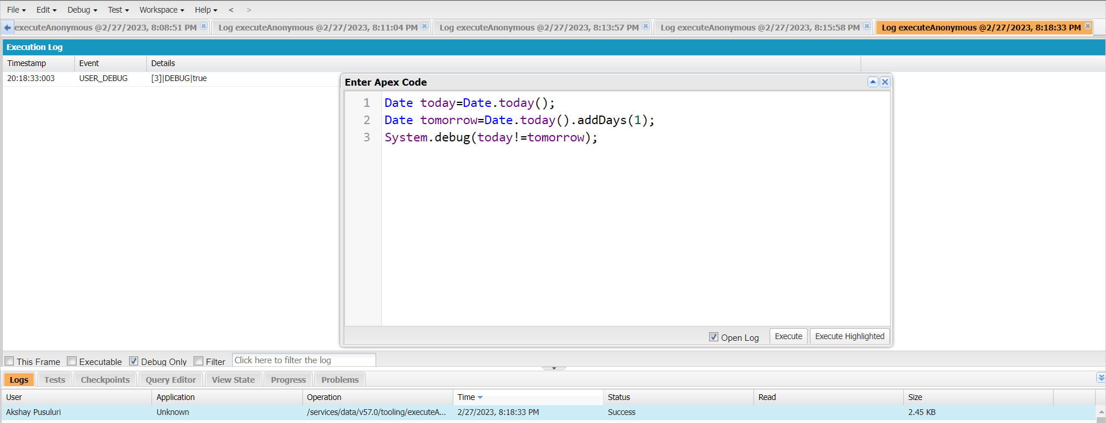
Exercise 5 Answer the following in True Or False: Date tomorrow = Date.today().addDays(1); Date today = Date.today(); today != tomorrow

Slide 35
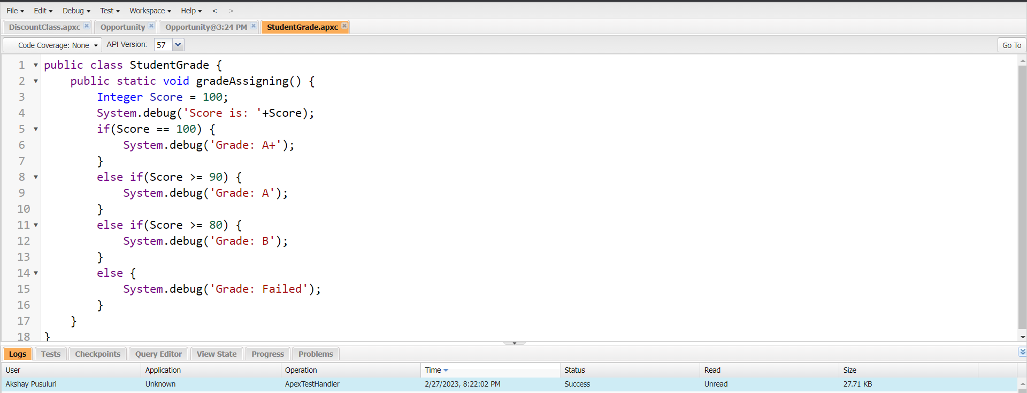
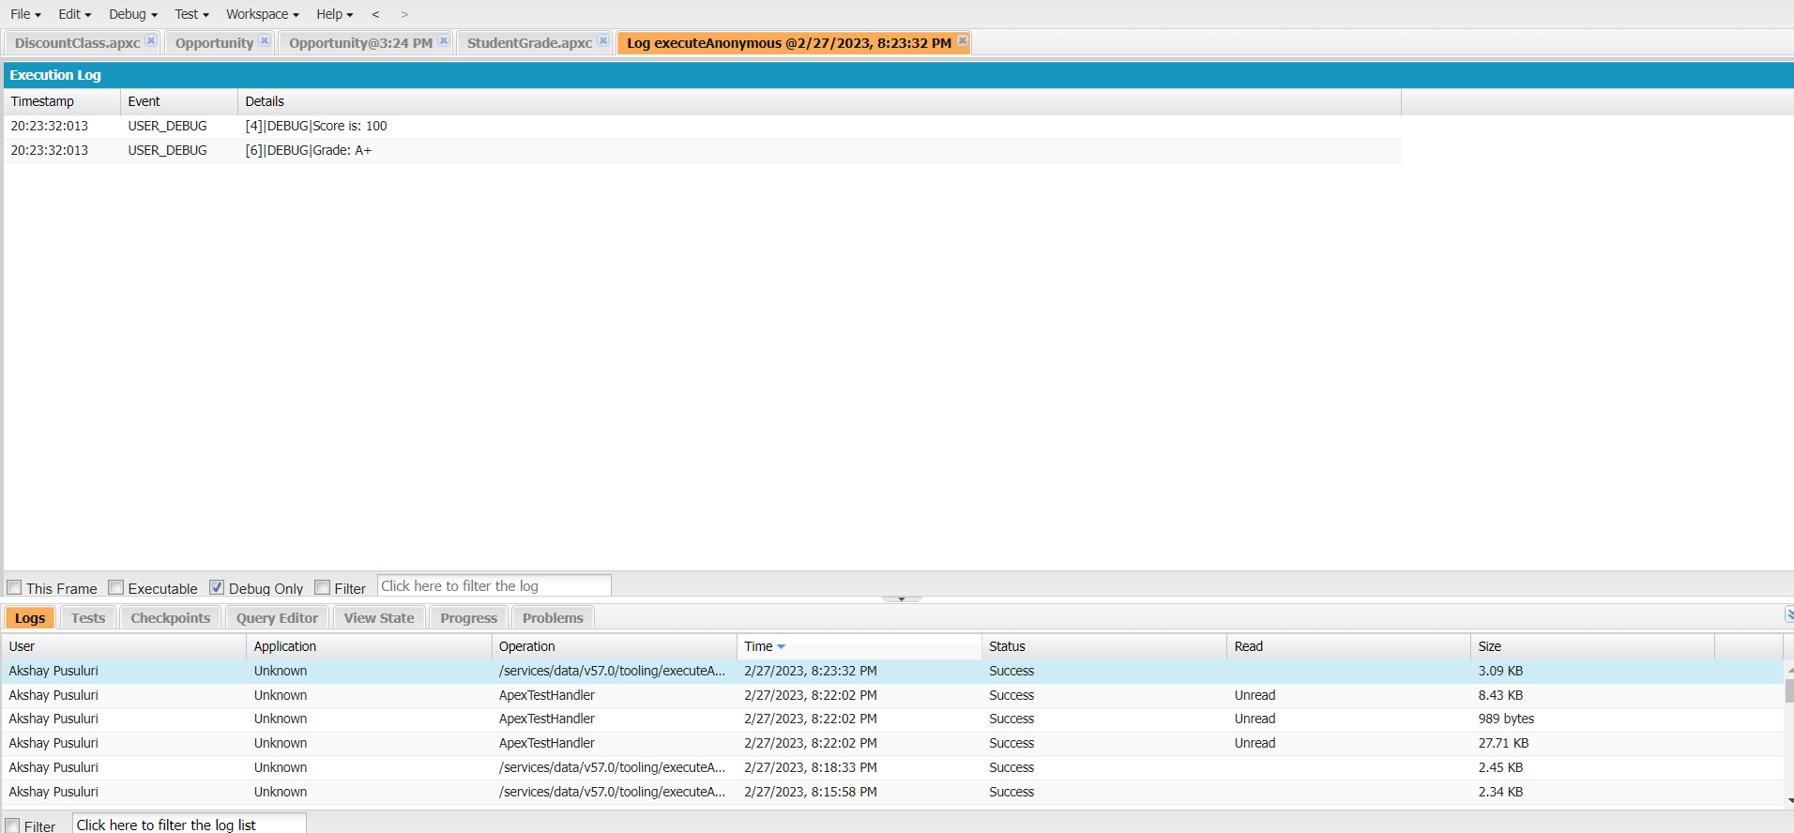
Exercise 6 Write a program and execute to demo the use of “If..else if...else”

Slide 36
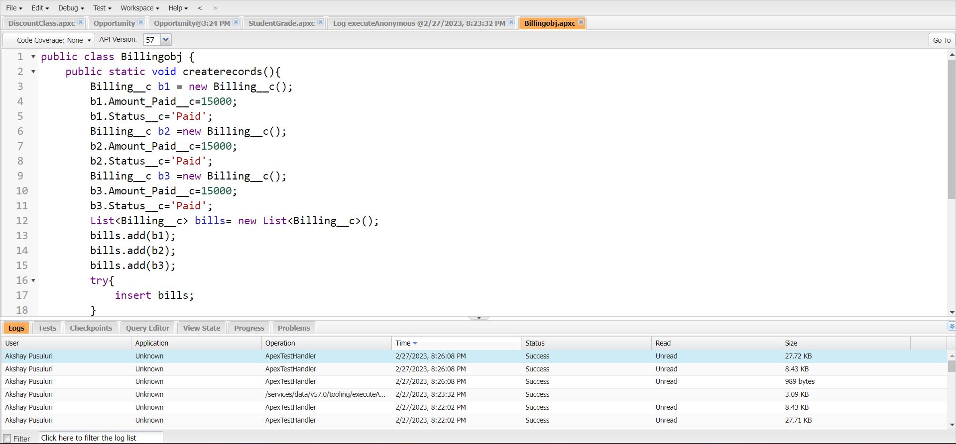
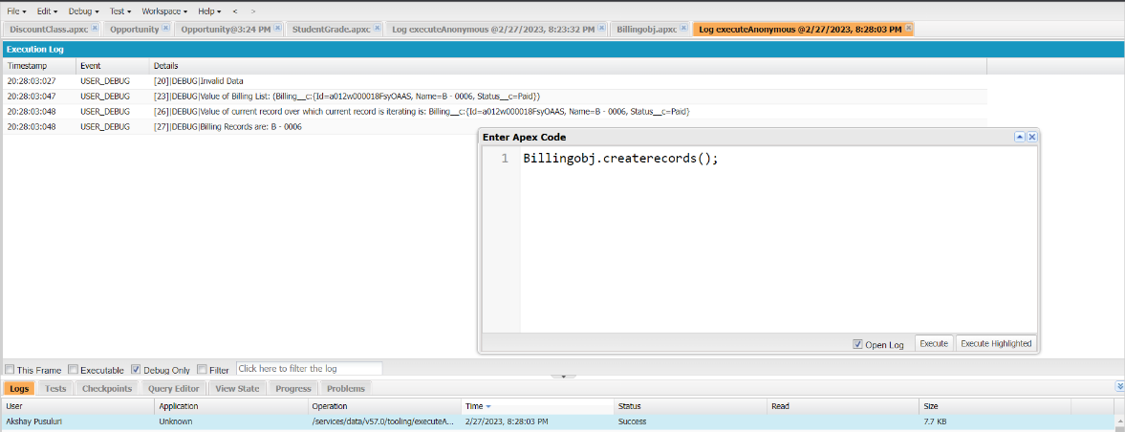
Exercise 7 Write a program to execute and demo the use of “Apex – for Loop”

Slide 37
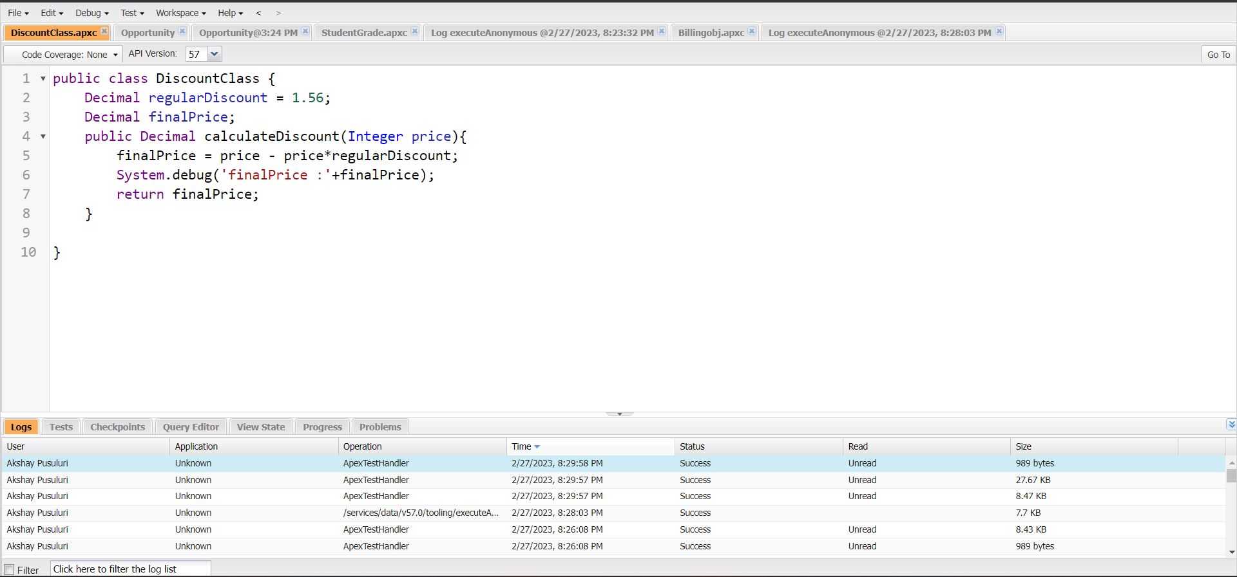
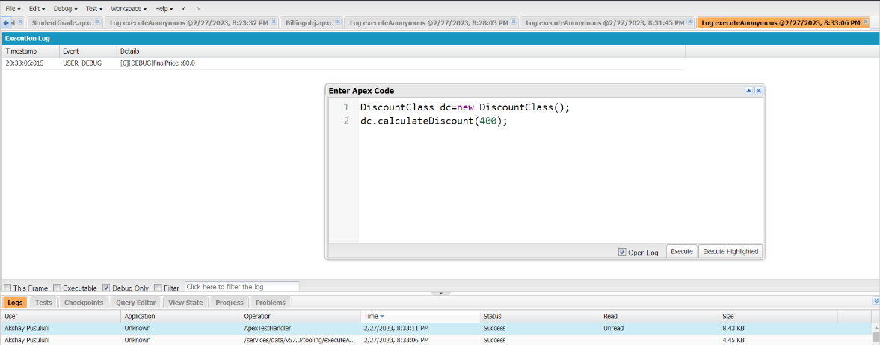
Exercise 8 Write a Class to demo the use of Constants in Apex

Slide 38
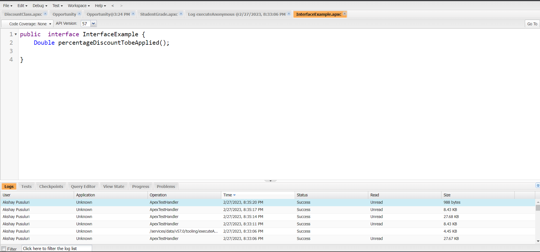
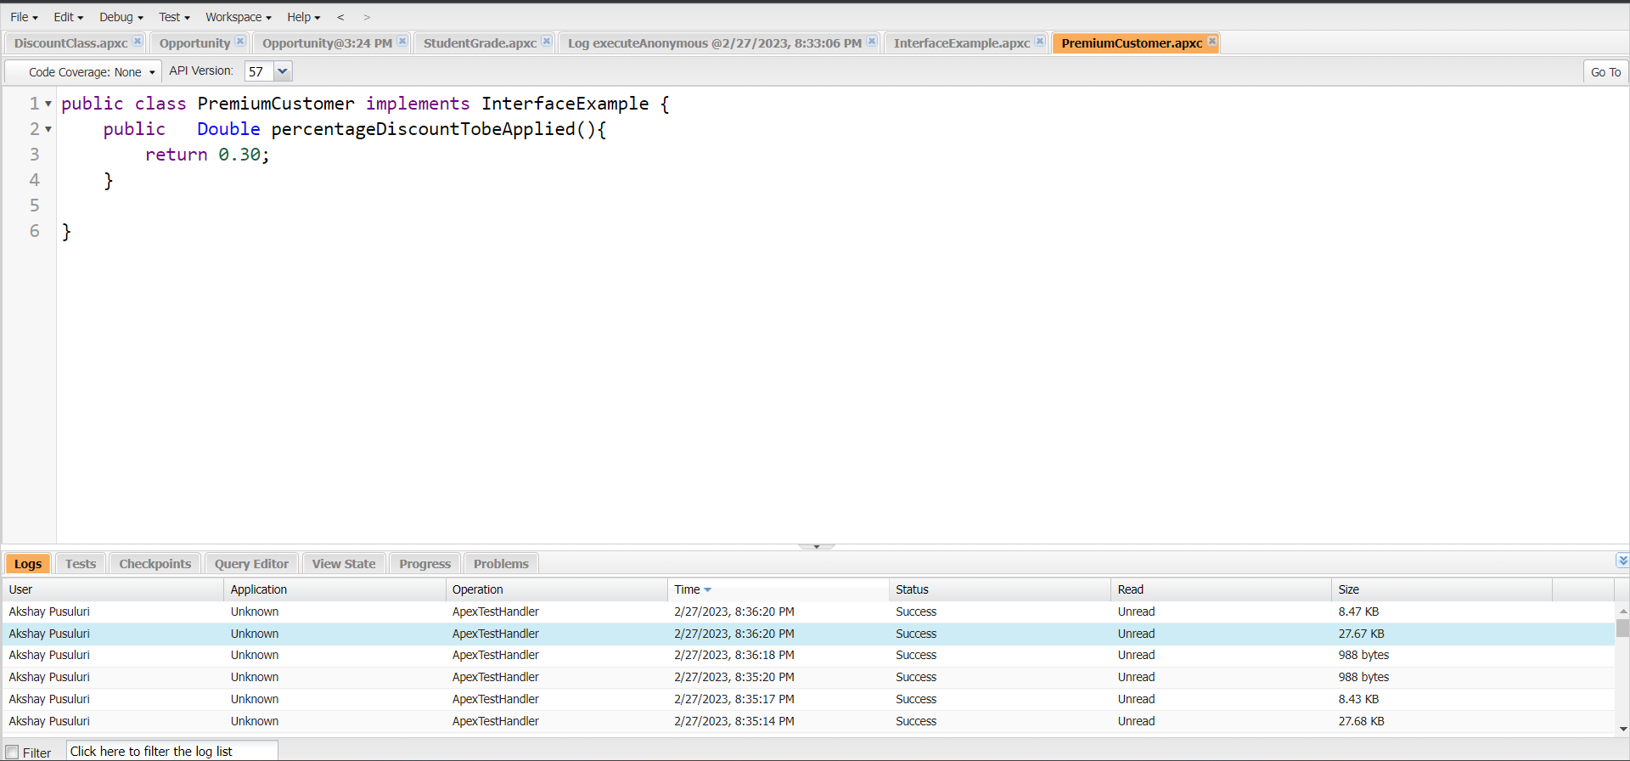
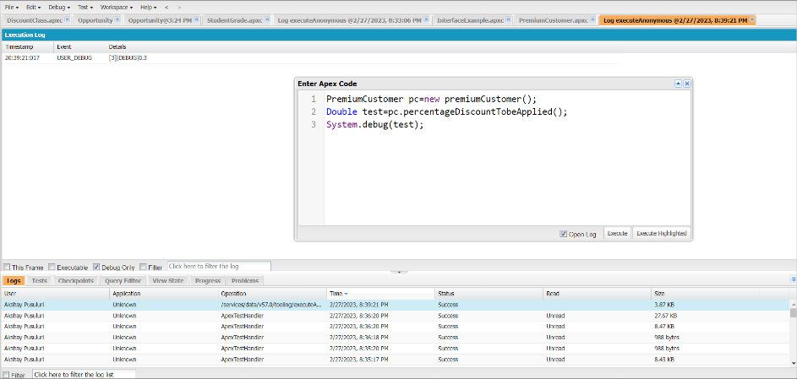
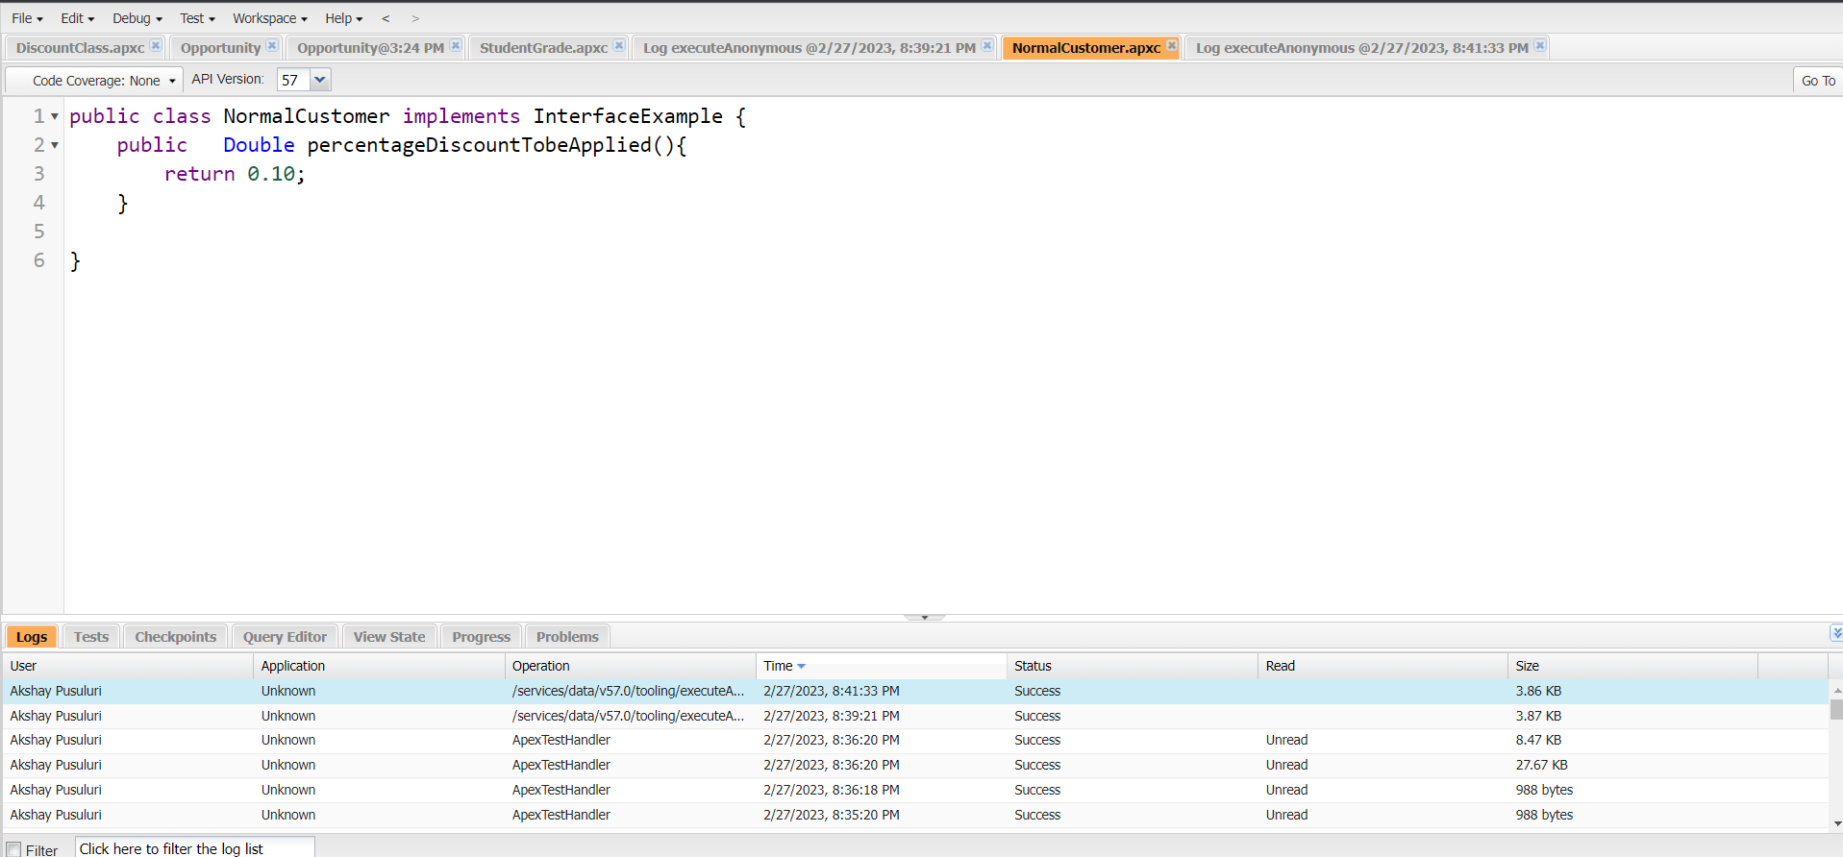
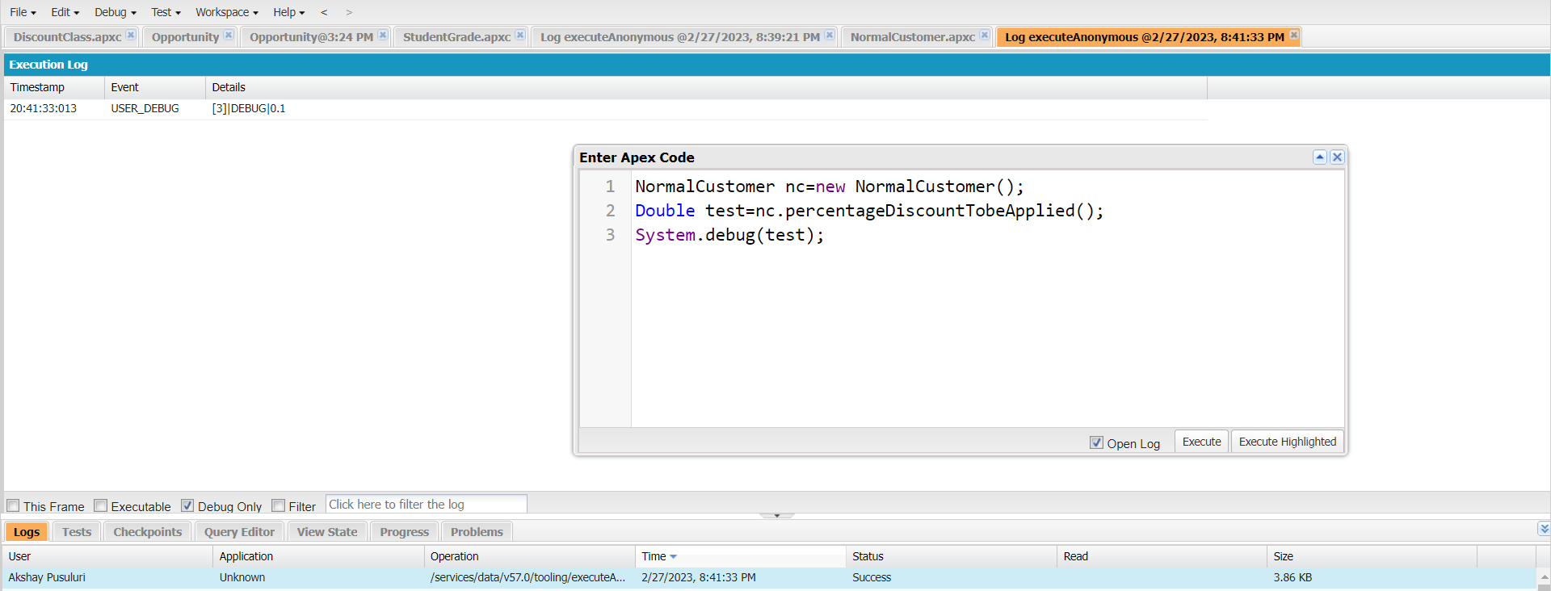
Exercise 9 Write a Class to demo the use of Interface in Apex

Slide 39
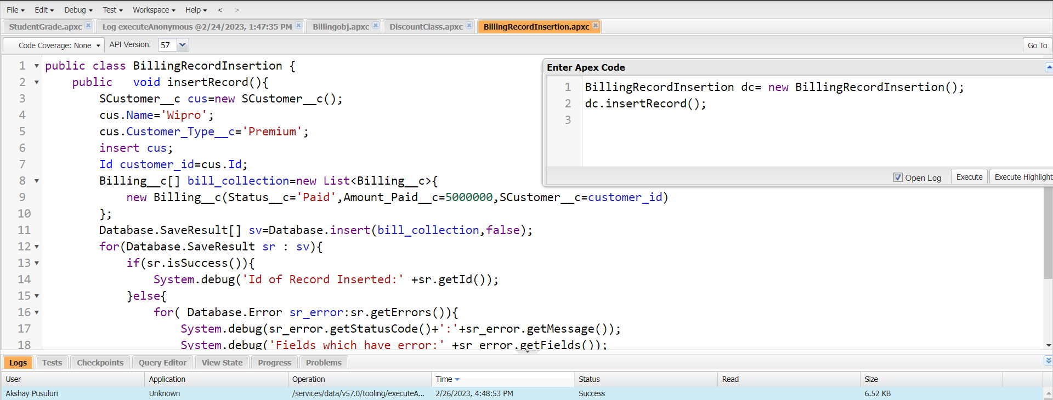
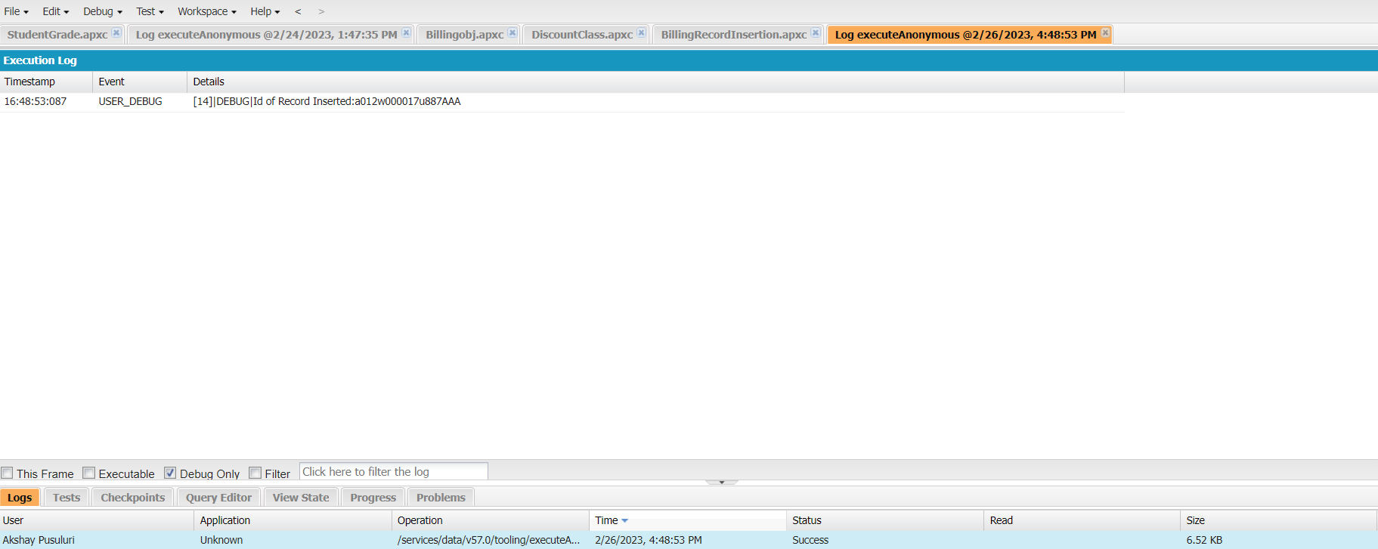
Exercise 10 Insert Billing record using Database methods Here use record id to insert customer

Slide 40
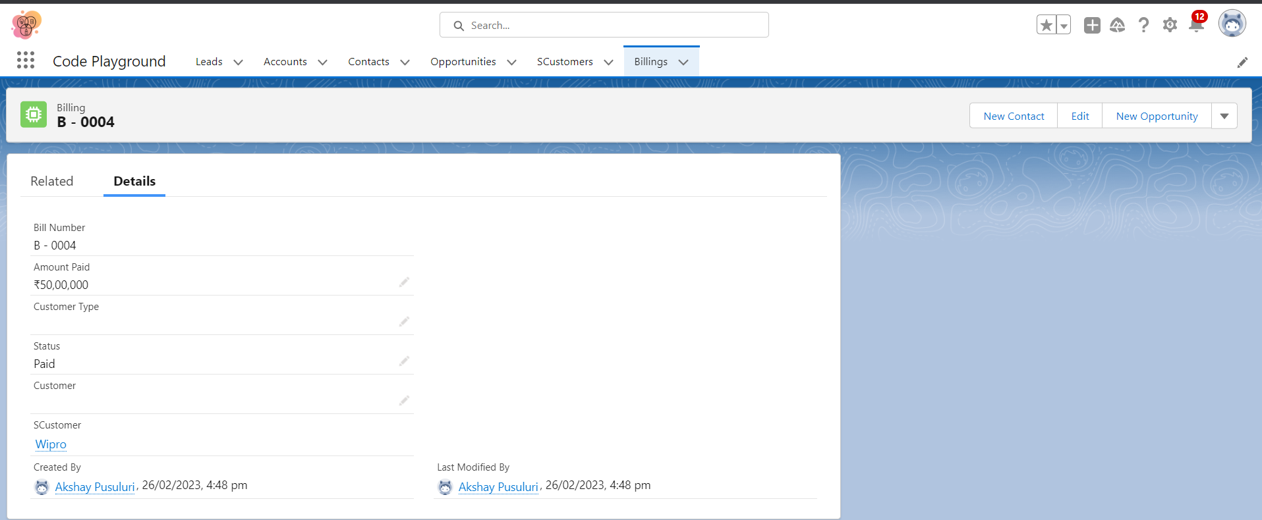

Slide 41
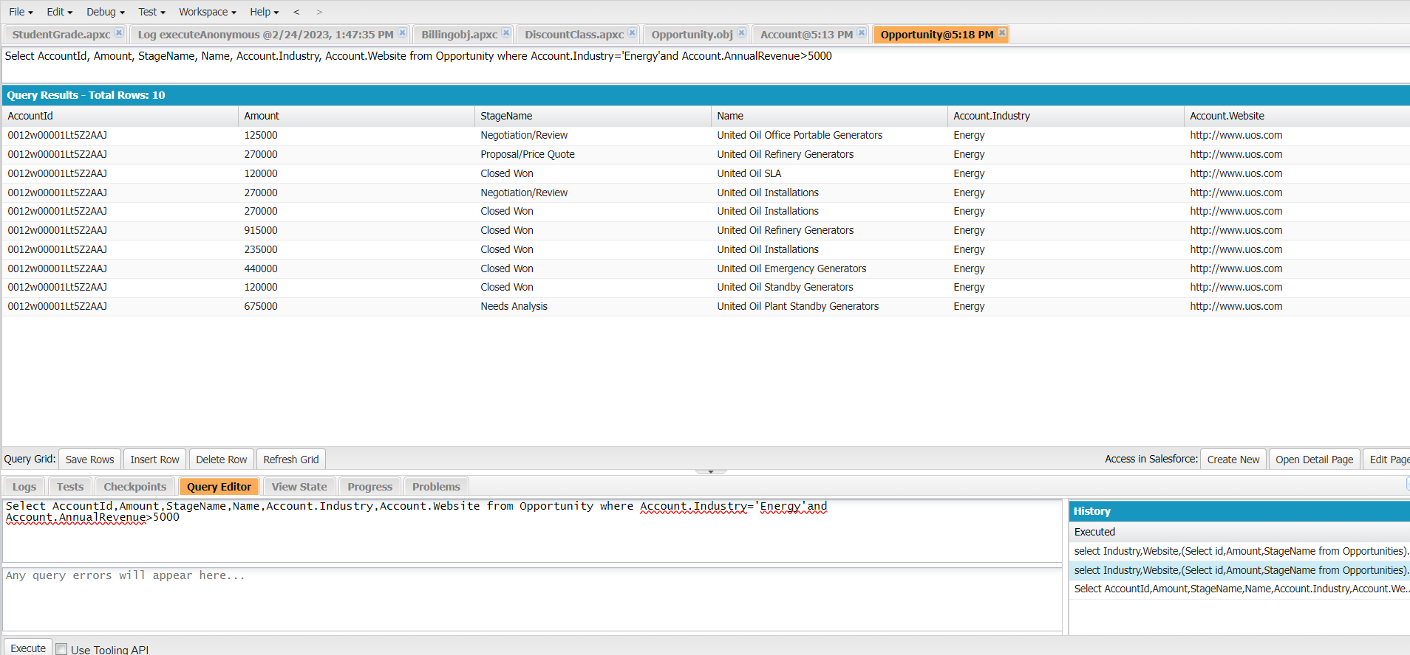
Exercise 11 Write and execute SOQL queries from Developer Console Display ID, Amount, Stage, Account Name, Account Industry, Account Website From Opportunity AND “Account Annual Revenue > 5000” Add a Where Clause “Account Industry = Energy”

Slide 42
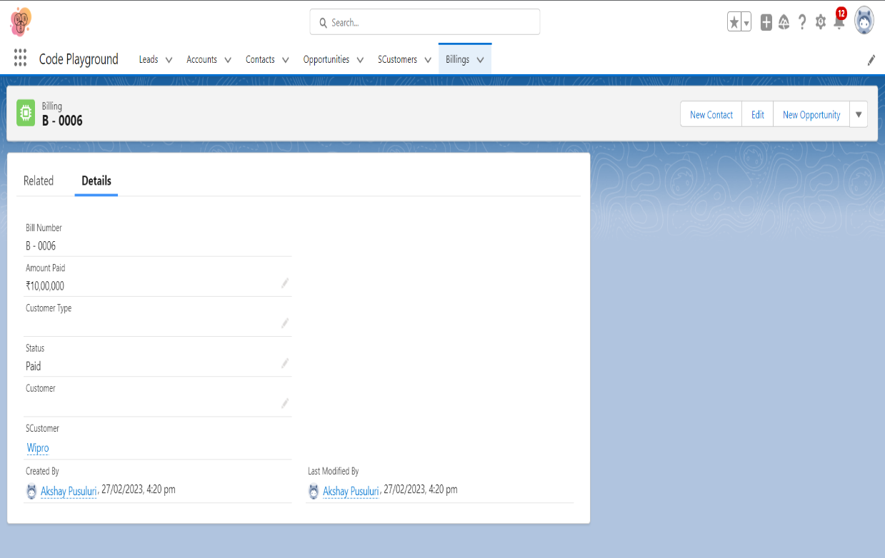
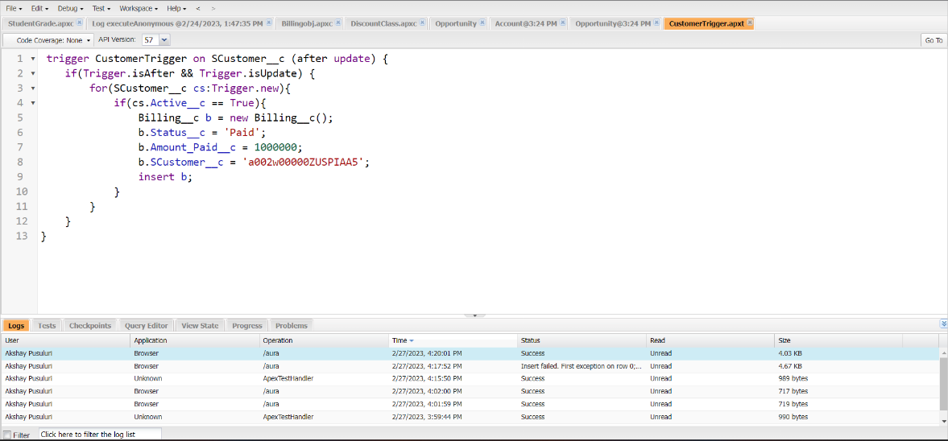
Exercise 12 Write an Apex Trigger, Name = CustomerTrigger. Create a Billing Record when on Customer Object the 'Status' field changes to Active from Inactive. Billing “Status” must be: Paid, Amount Paid = 1000000 Perform the DML on a List.

Slide 43

Exercise 13 Write a Test Class for CustomerTrigger. Create the Data for the Customer custom Object Use Test.startTest() & Test.stopTest(). Use assert statement to validate the output, Test Class must have full code coverage.

Slide 44



Exercise 14
ApexTrigger,Name=DisqualifyTestLeads

Slide 45



Exercise 15
Write a Test Class for DisqualifyTestLeads.

Slide 46


Exercise 16 Create a Visualforce page which displays Opportunity fields as output fields.

Slide 47


Exercise 17 Create a Visualforce page which shows a list of Accounts linked to their record pages

Slide 48



Exercise 18 Create a Visualforce page that uses a custom controller to display a list of cases with the status of 'New'. The page must be named NewCaseList.

